Slide 1
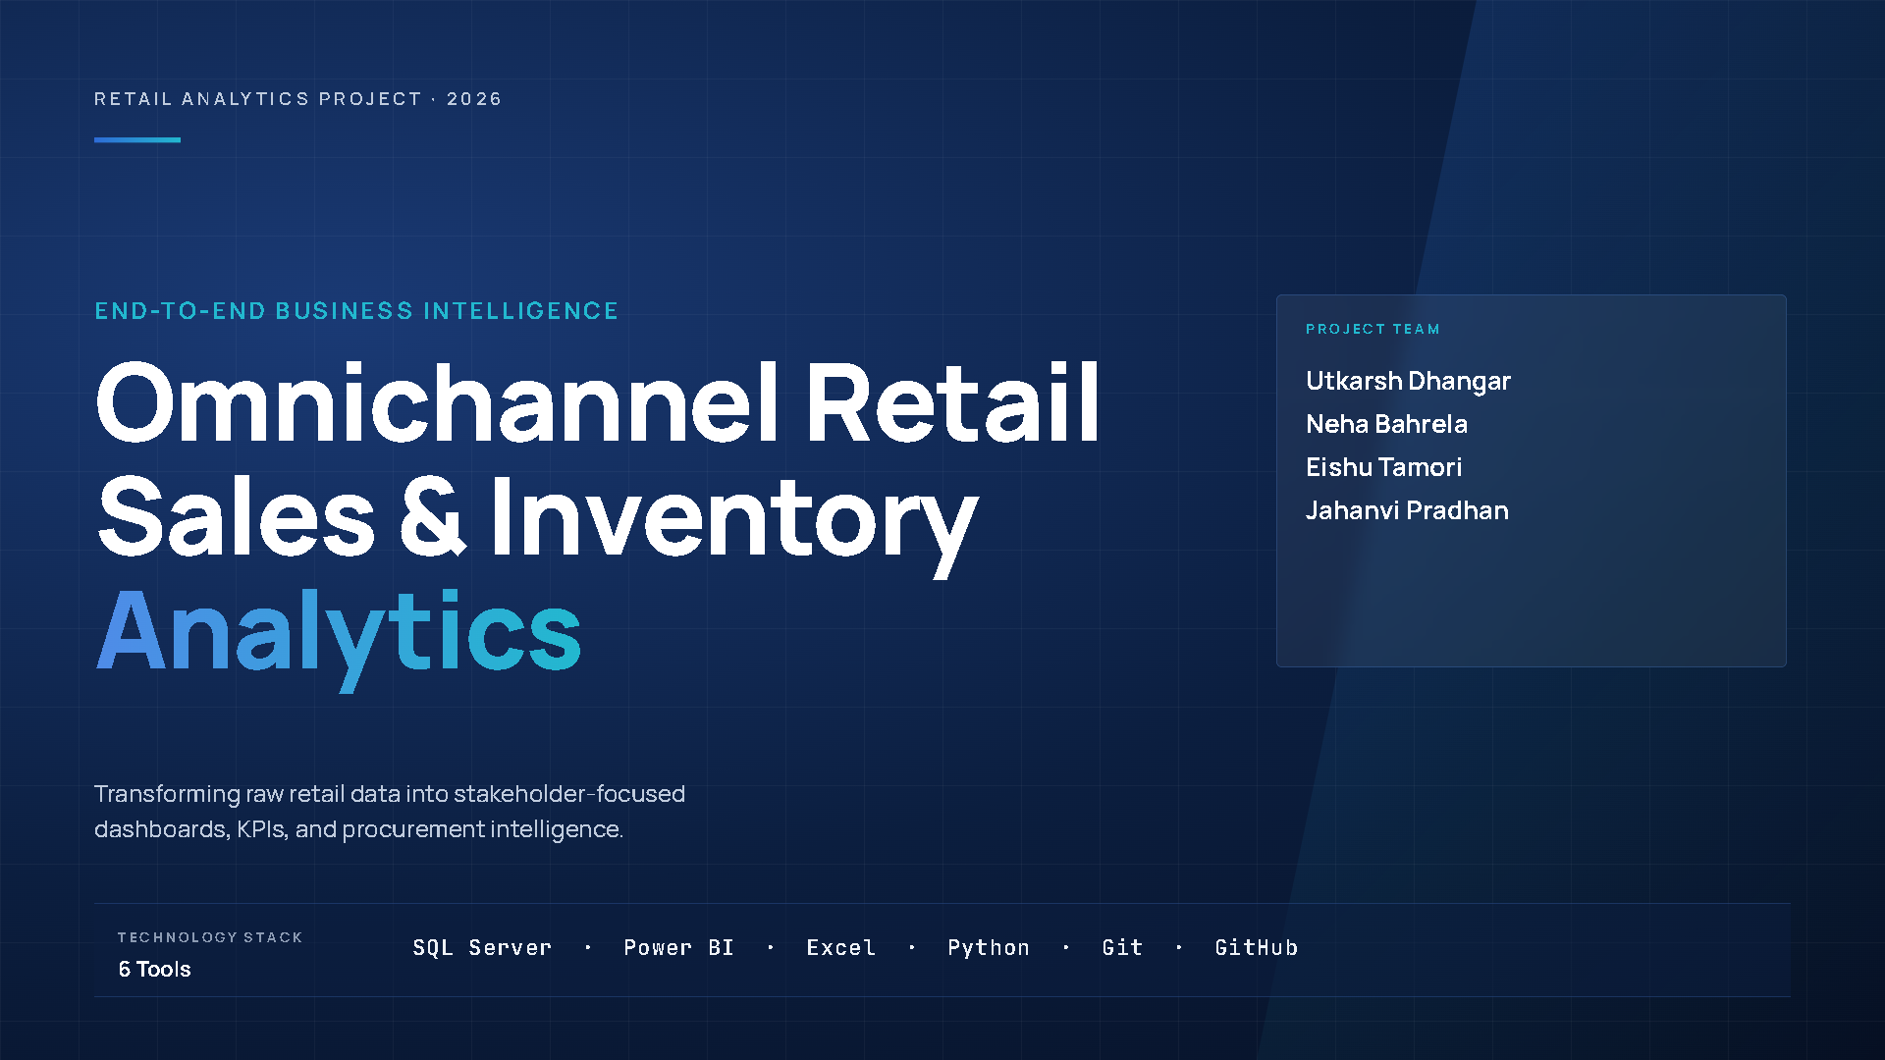

Slide 2
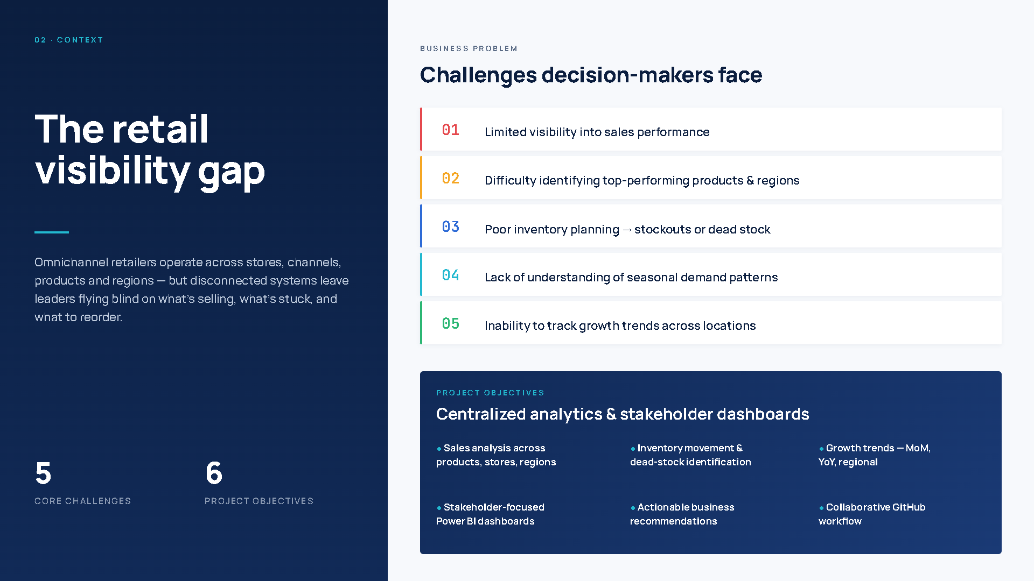

Slide 3
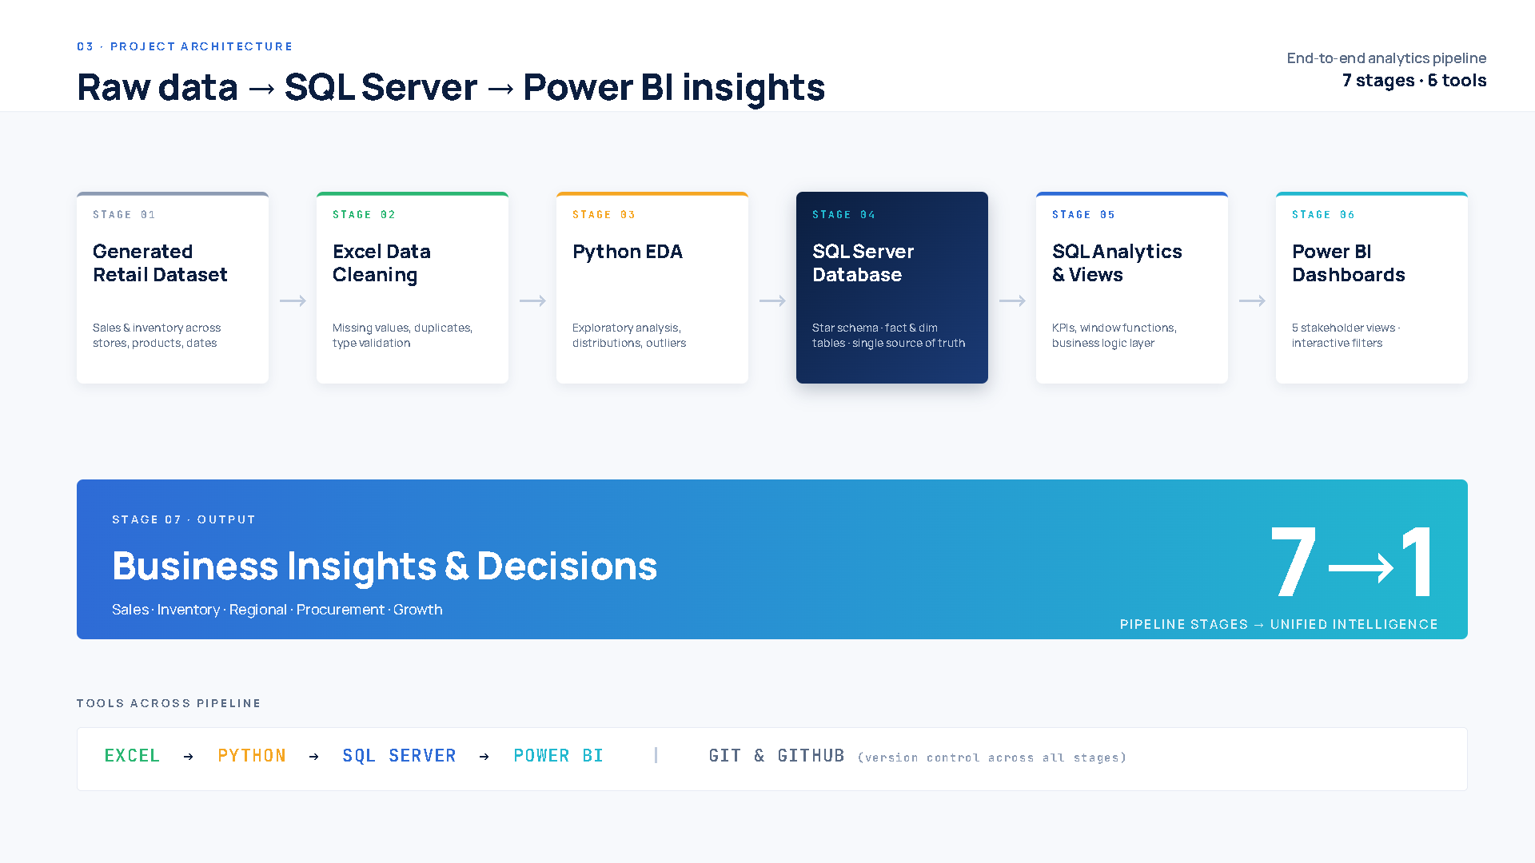

Slide 4
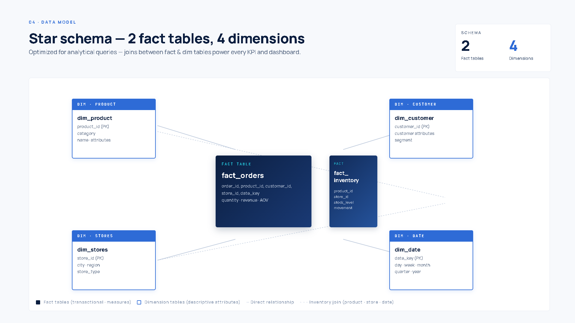

Slide 5

Key Performance Indicators
Four headline metrics define the commercial baseline — the foundation for all subsequent regional, category, and temporal analysis.
$1.32B
20K
Total Revenue
Total Orders
Across all channels, regions, and categories
Processed through the omnichannel platform
$65.8K
59.9K
Average Order Value
Units Sold
High-value B2B and enterprise transactions
Across all product categories and SKUs
YoY revenue trend: -1.77% overall. North region led revenue contribution; East region declined -6.10%.

Slide 6
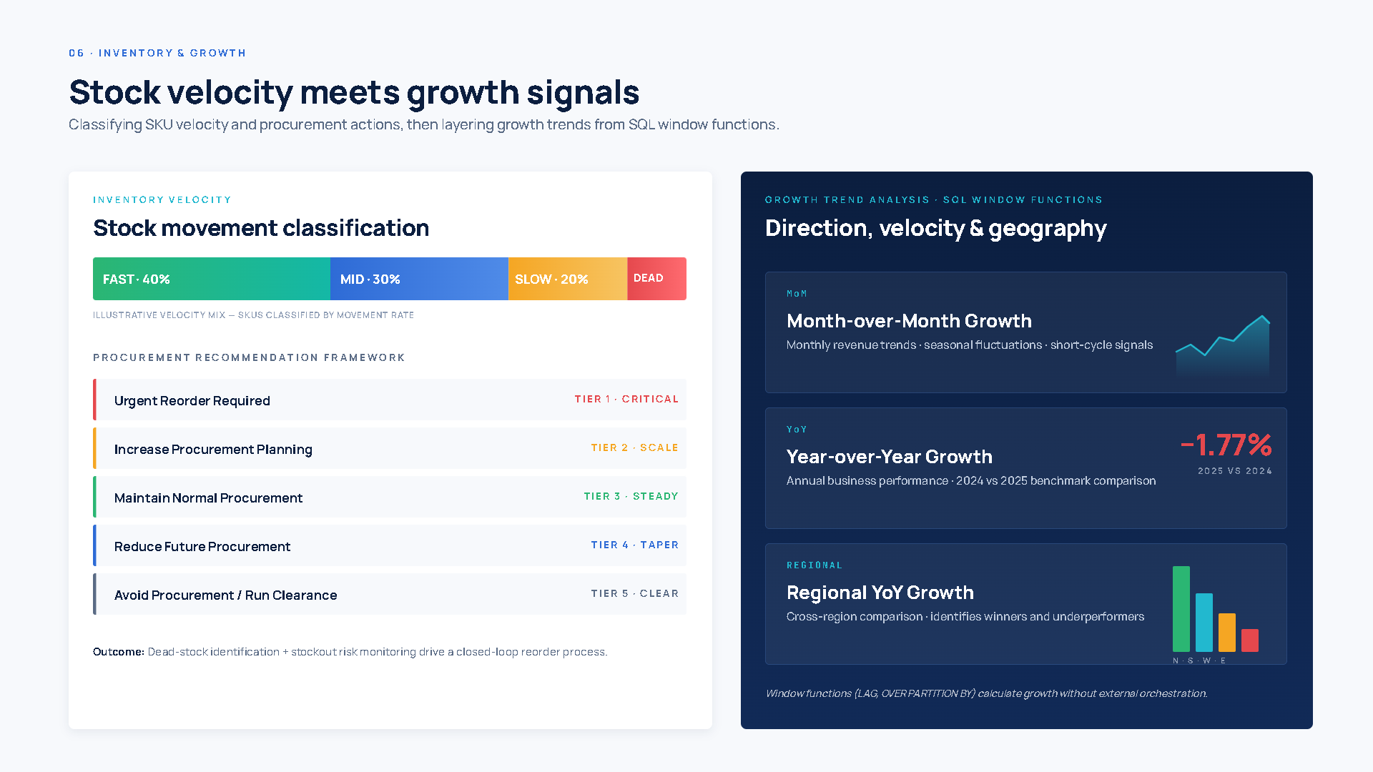
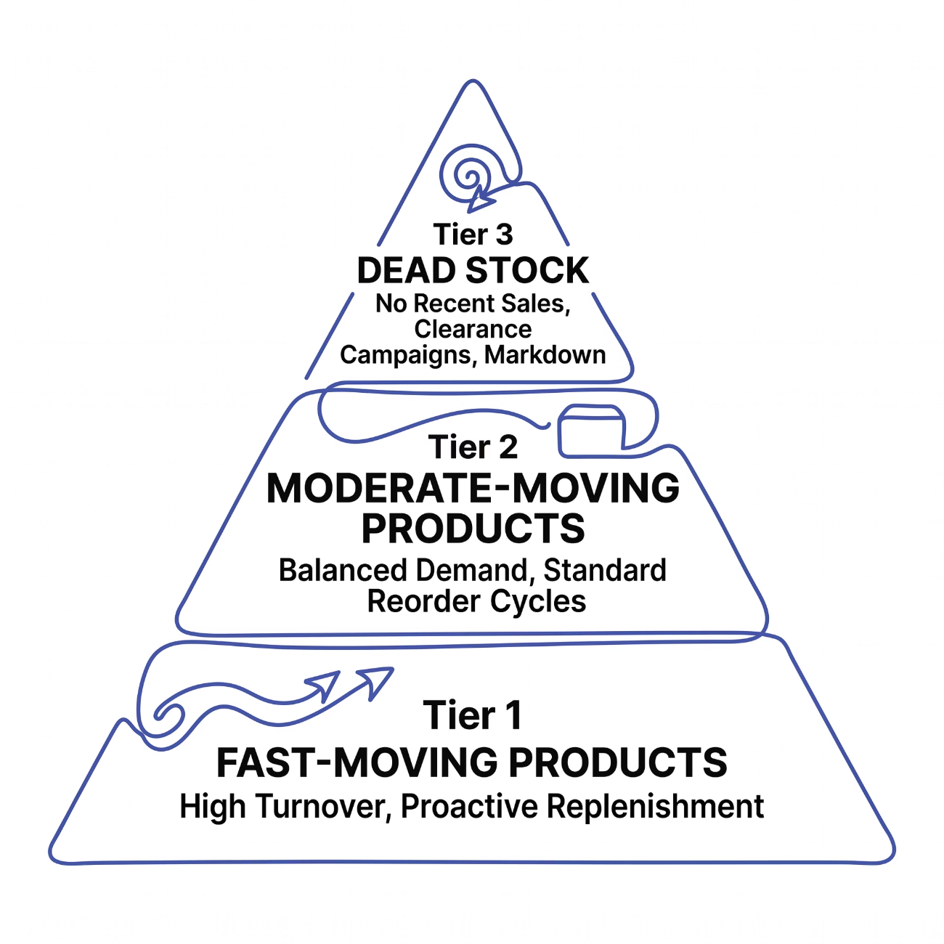
Inventory Analysis & Procurement Framework
Inventory performance was segmented into three tiers to guide procurement priorities and clearance strategies. Fast-moving products require proactive replenishment to prevent stockouts, while dead-stock items demand targeted clearance campaigns to free working capital.
Fast-Moving
Moderate-Moving
Dead Stock
Proactive replenishment to prevent stockouts
Standard reorder cycles and monitoring
Clearance campaigns and markdown strategy

Slide 7
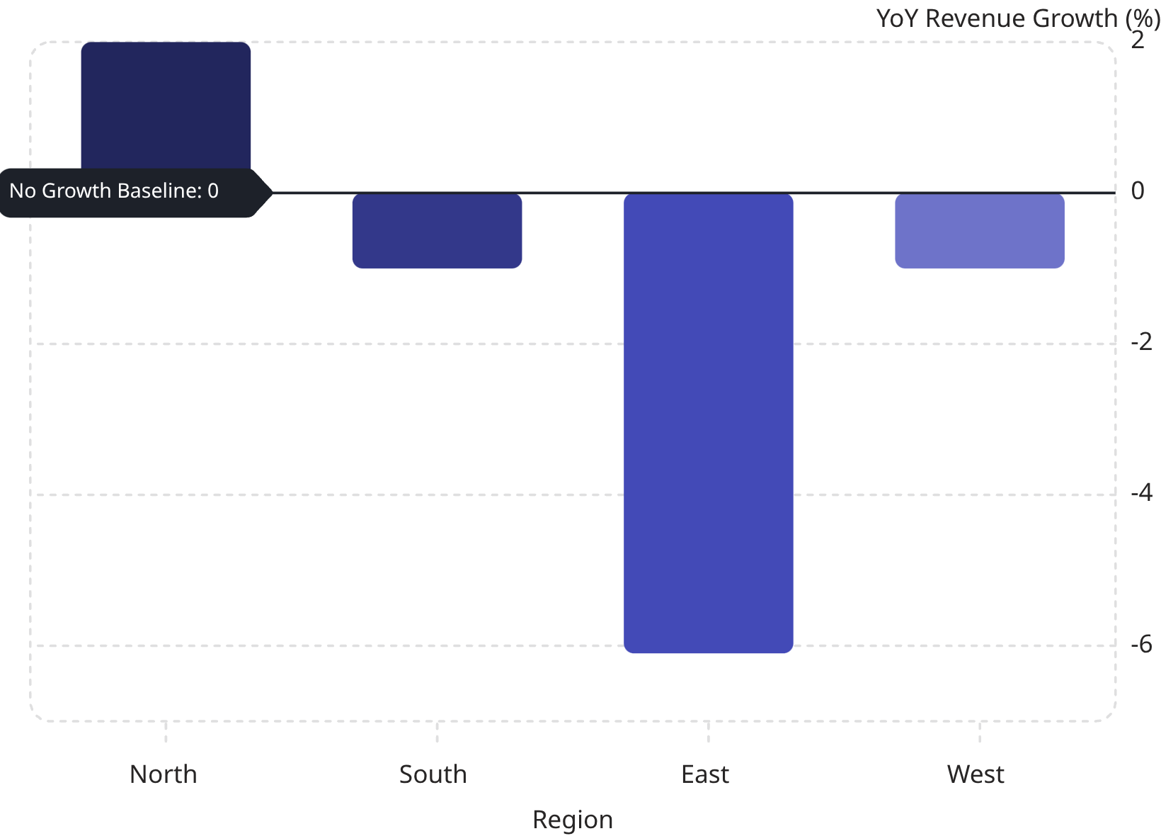
Growth Trend Analysis
Regional YoY Performance
Only the North region achieved positive YoY growth. The East region's -6.10% decline is the primary drag on overall performance and warrants immediate investigation.
Q4 demonstrated the strongest seasonal demand across all regions
Beauty & Fashion were the top-performing categories by revenue
Overall MoM trends show recovery momentum entering Q4

Slide 8
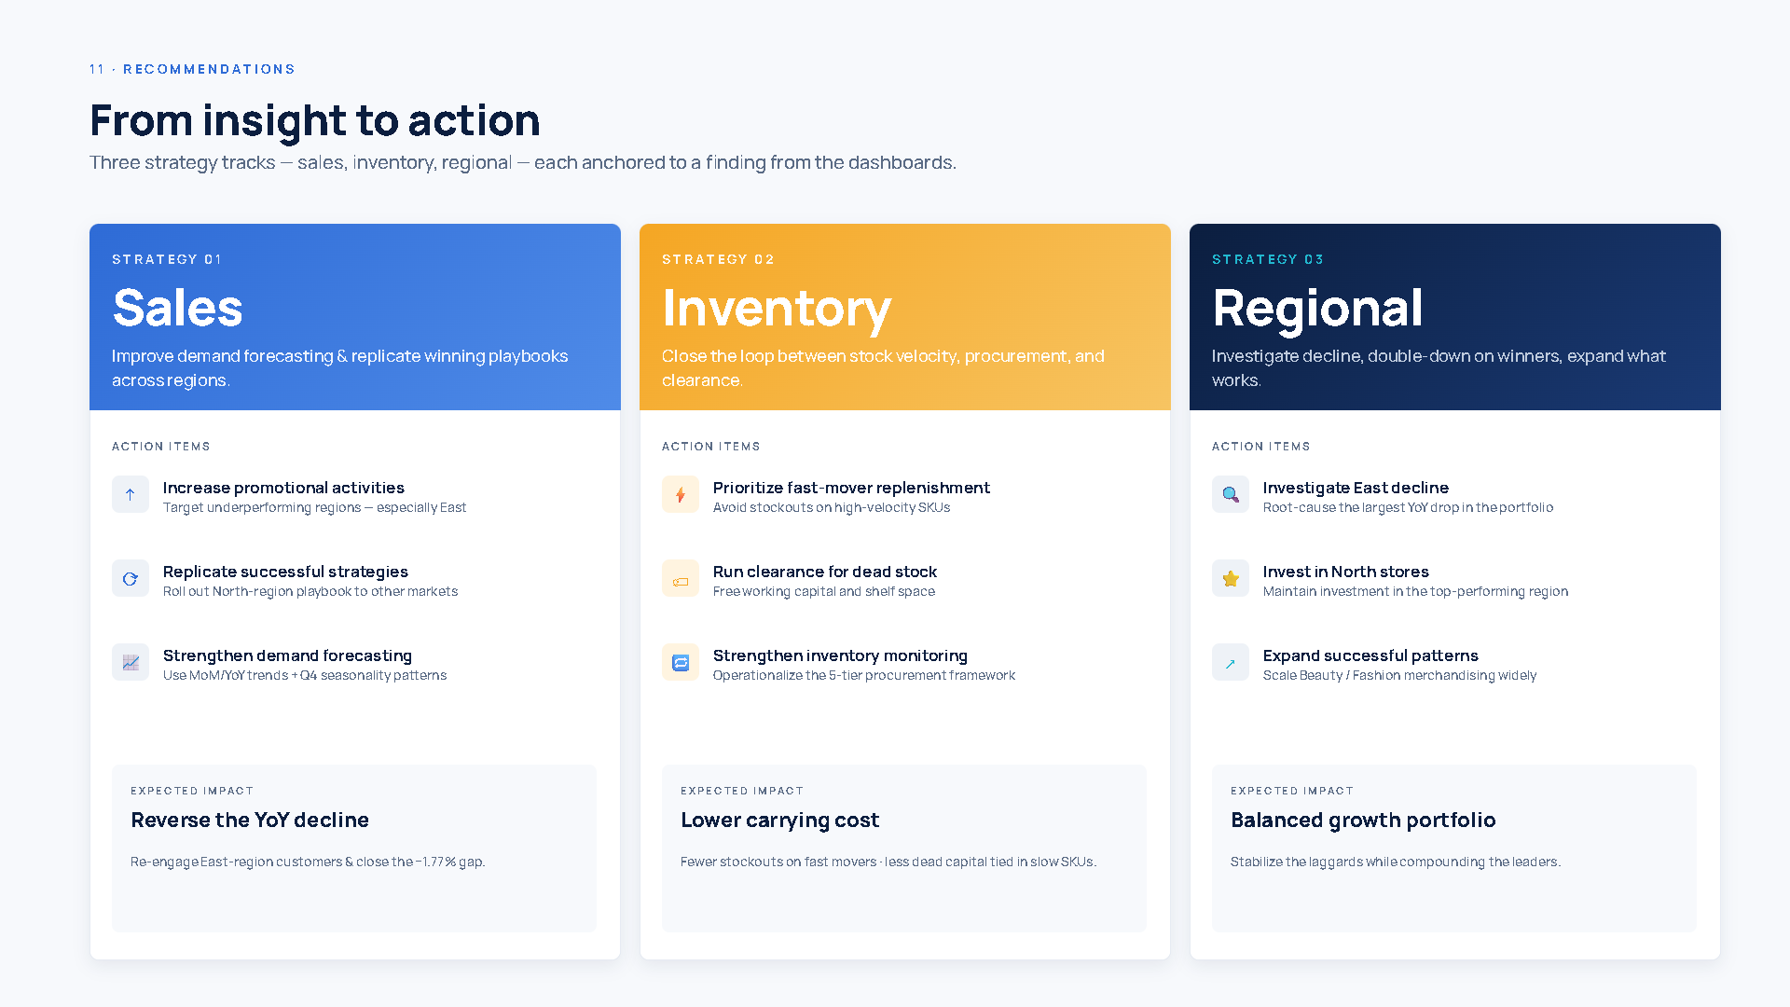
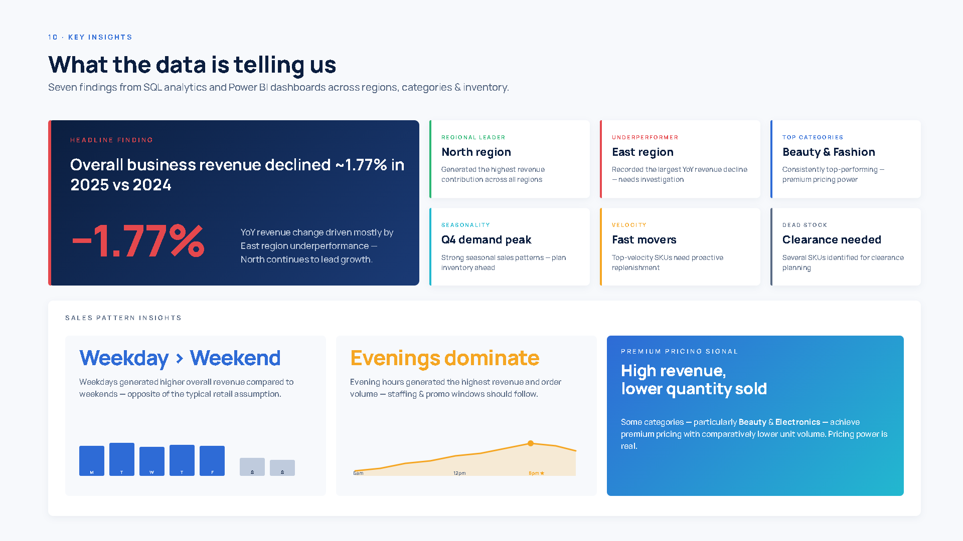

Slide 9
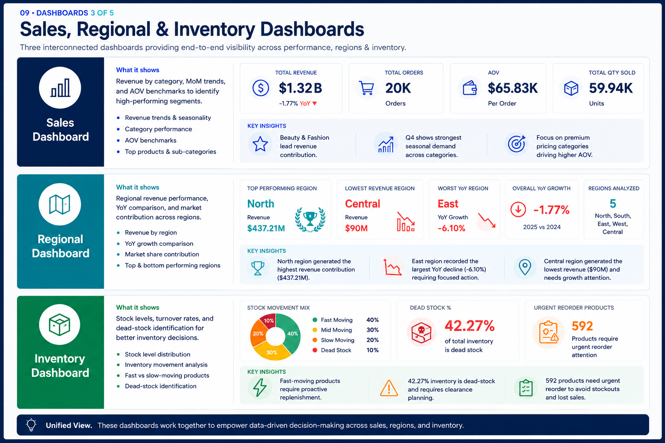

Slide 10



Key Insights, Recommendations & Conclusion
Strategic Recommendations
Project Conclusion
This project delivers a production-ready analytics framework — from ETL pipeline to executive dashboards — enabling data-driven decisions across sales, inventory, and regional operations.
Sales Strategy
Inventory Strategy
Increase promotions in underperforming regions; replicate North's winning playbook.
Prioritize fast-mover replenishment; launch clearance campaigns for dead stock.
Core Achievement: A unified analytics layer transforming $1.32B in transactional data into strategic intelligence for omnichannel retail leadership.
Regional Strategy
Operational Strategy
Investigate East region decline; expand North practices; monitor trends via dashboards.
Strengthen procurement planning; centralize analytics for faster decision-making.

Slide 11
